Slide 1

Final Project
KHIN MOE MOE LATT-202555378
Rock Paper Scissors Game with GUI
19 February, 2025

Slide 2
Introduction
Rock Paper Scissors is a classic hand game that has been played for generations around the world as a simple, fair way to make decisions or settle disputes. In this project, I recreated the game using Python and the Tkinter library to provide a graphical user interface (GUI), making it accessible and engaging for users of all ages. The game allows players to select rock, paper, or scissors with a button click, while the computer randomly chooses its move. The project not only demonstrates the fundamentals of Python programming and event-driven design, but also highlights how traditional games can be brought to life through modern software development tools

Slide 3


Project Objectives
Objectives
Implementation Plan
Develop an interactive Rock Paper Scissors game using Python with a graphical user interface (GUI) built on Tkinter.
Provide a user-friendly experience with easy move selection, real-time result display, and score tracking.
Demonstrate core programming concepts such as event-driven design, randomization, and score management in a fun and accessible way
Traditional Rock Paper Scissors programs are often text-based, which can be less engaging and allow for input errors.
There is a need for a more intuitive and robust solution that eliminates invalid inputs and enhances user interaction.
This project addresses these issues by creating a GUI-based game that is visually engaging, easy to use, and robust against invalid input, while also showcasing fundamental programming skills.

Slide 4
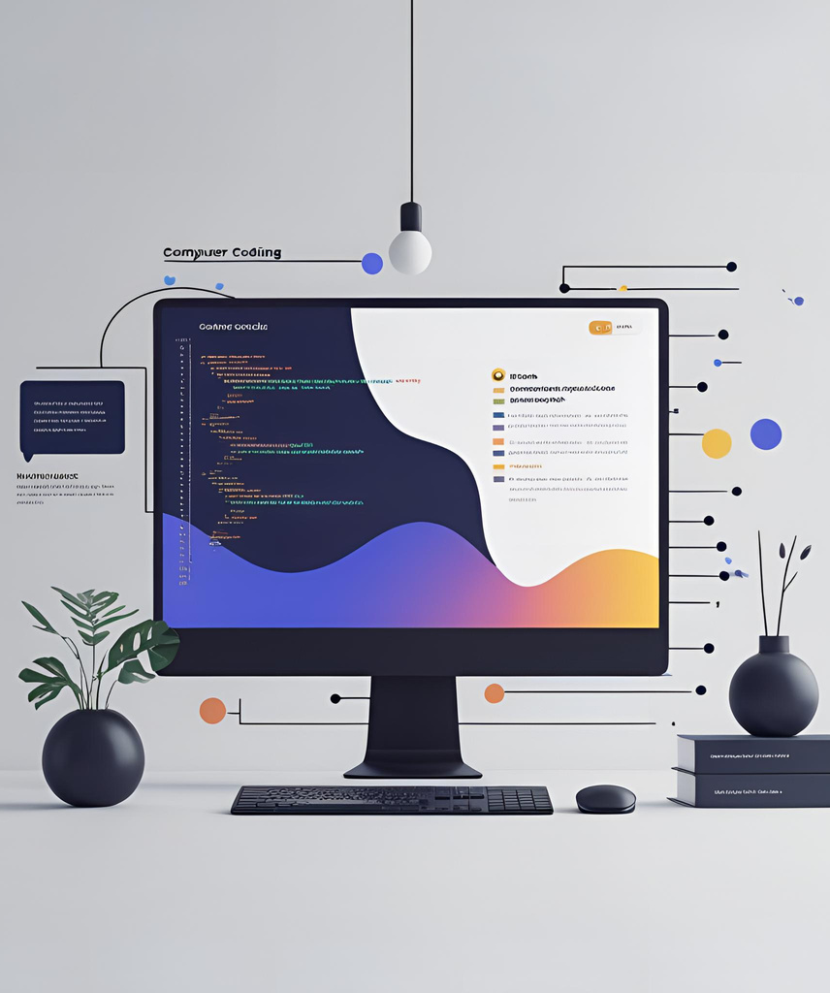
Design and Implementation
The game features a graphical user interface (GUI) built with Python’s Tkinter library, providing buttons for Rock, Paper, and Scissors selection.
The interface displays the computer’s choice, the result of each round (win, lose, tie), and real-time score tracking for both the player and the computer.
The game logic uses Python’s random module to generate the computer’s move and compares it with the player’s choice to determine the outcome.
Event-driven programming is used: each button click triggers the main game function, updates the display, and manages the scores.
The application is self-contained, requires only Python 3.x, and runs on any major operating system without additional dependencies

Slide 5
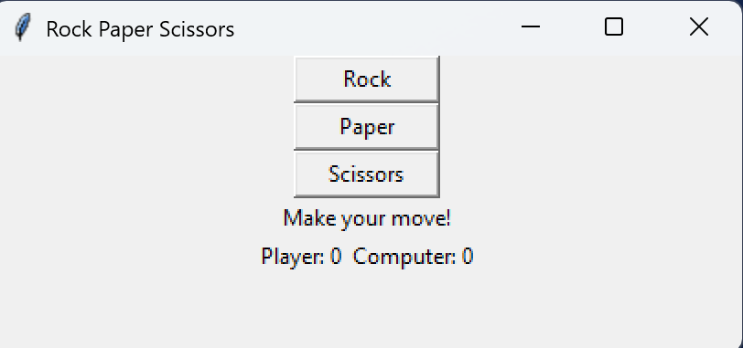
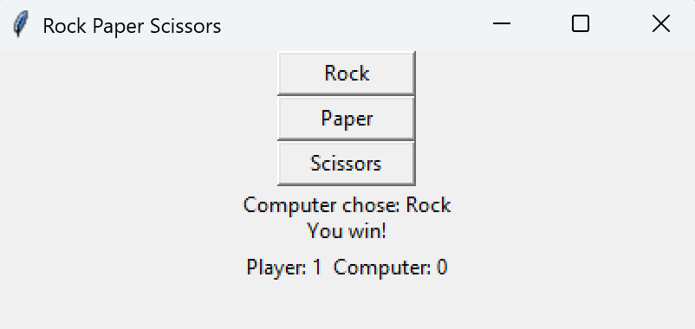
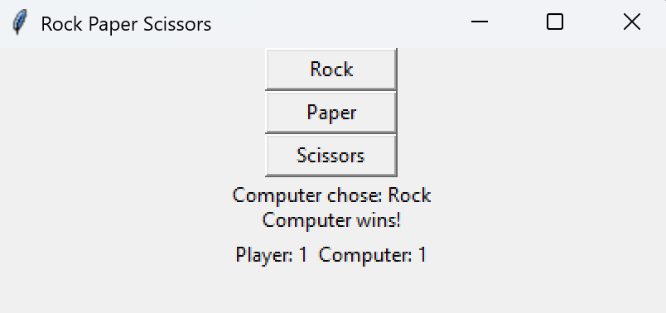
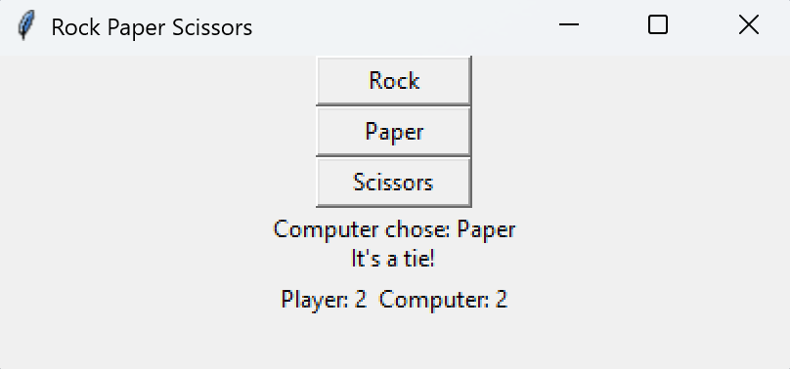

Demonstration

Slide 6

Result and Analysis
The game runs smoothly on Windows with Python 3.x and requires no additional dependencies.
The GUI interface enables intuitive gameplay, eliminating invalid input and making the game accessible to all users.
Score tracking and result display update in real time after each round, providing immediate feedback and enhancing user engagement.
Testing confirmed robust performance, correct application of game rules, and accurate score management throughout repeated play sessions.
The project successfully demonstrates the integration of event-driven programming and GUI design in Python, fulfilling the original objectives and providing a solid foundation for future enhancements

Slide 7
Conclusion
The project delivered a user-friendly Rock Paper Scissors game with a simple GUI and real-time score tracking.
The game is robust, easy to use, and demonstrates key programming concepts in Python.
Future improvements could include enhanced visuals, sound, or saving scores.
Thank you for your attention!

Slide 8
Thank you

